Slide 1

Event Master Plugin for Stream Deck
Event Master Plugin version 2.0
Requires Event Master version 7.0 or greater
Requires Streamdeck version 4.1 or greater

Slide 2
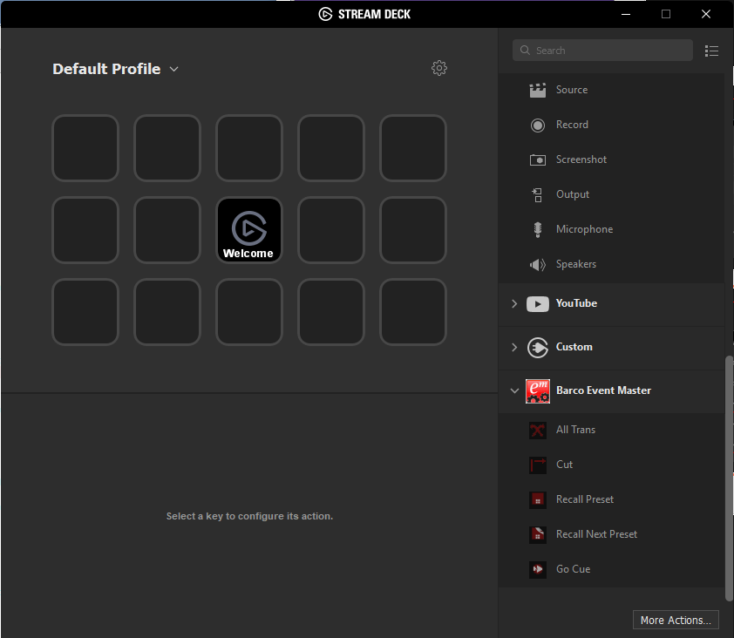
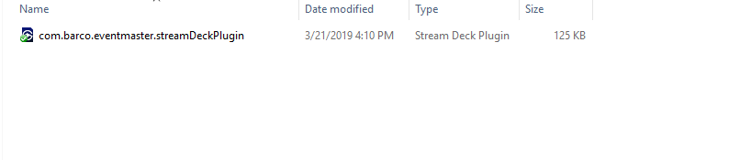
Install the Stream Deck Event Master plugin
Double clicking the plugin will automatically install it
Current version is 2.0
Compatible with Streamdeck v4.1 or greater

Slide 3
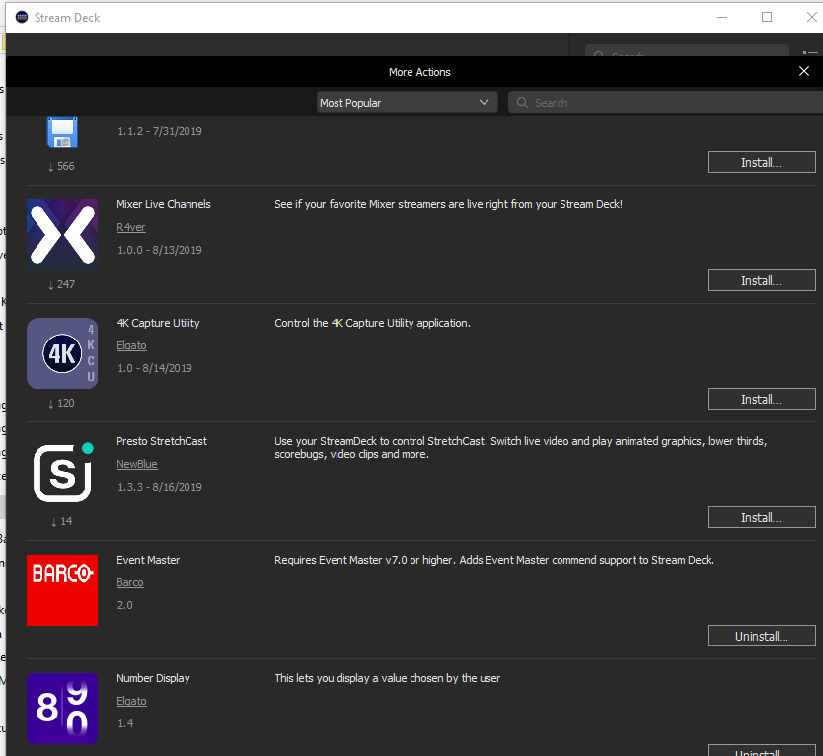
What you should see after installing the plugin

Slide 4
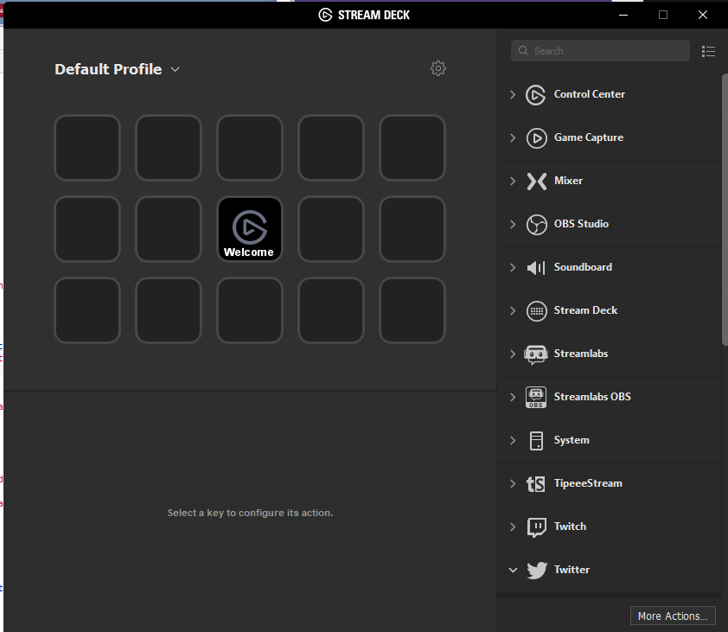
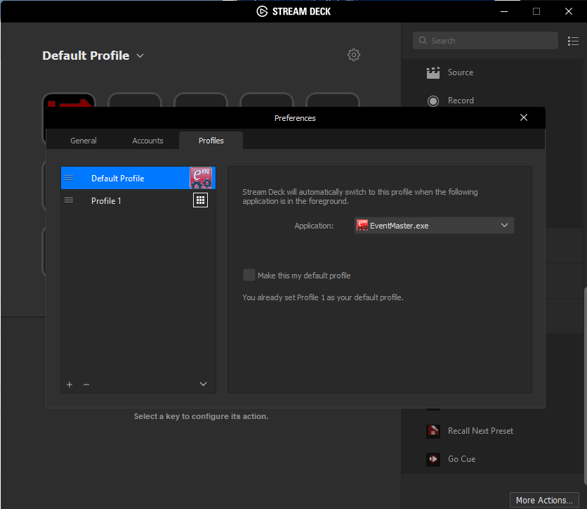
Automatically open EMT
Update profile preferences and select Event Master Toolset

Slide 5
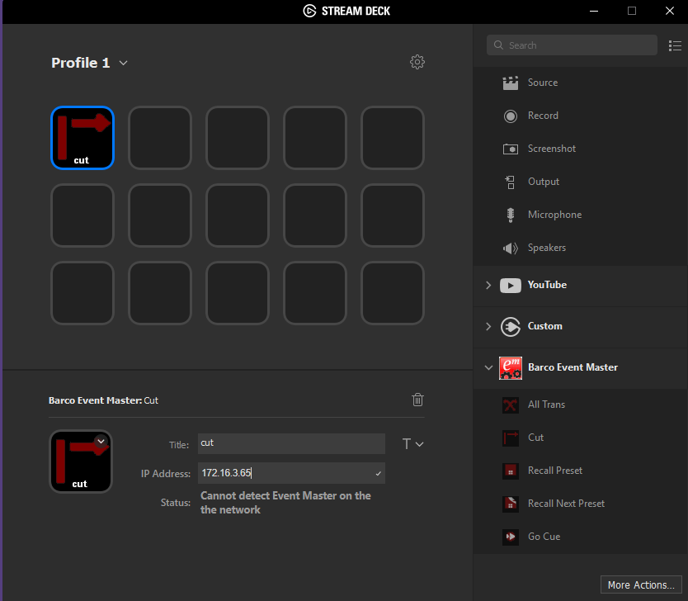
Cut Action
Drag and drop the action icon to the desired button

Slide 6
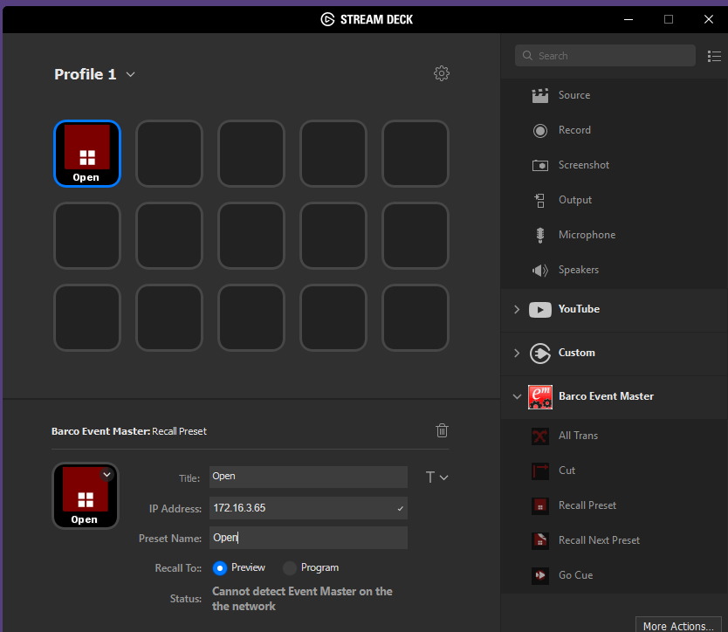
Recall Preset Action
Drag and drop the action icon to the desired button
Provide:
Name and IP address
Recall to Preview or Program
Status will display “Connection Established” if able to connect to Event Master

Slide 7
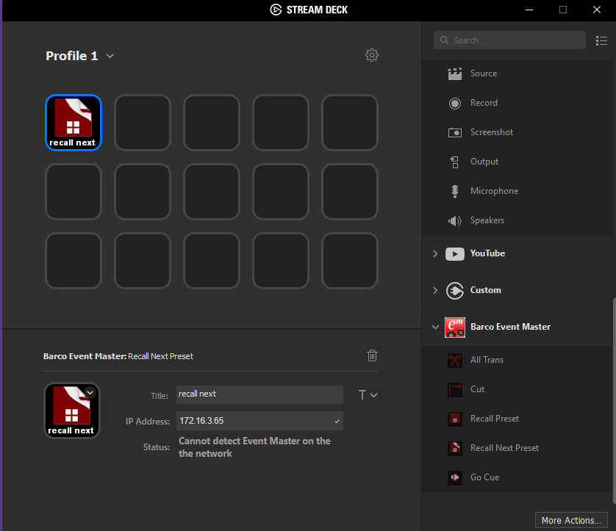
Recall Next Preset Action
Drag and drop the action icon to the desired button

Slide 8
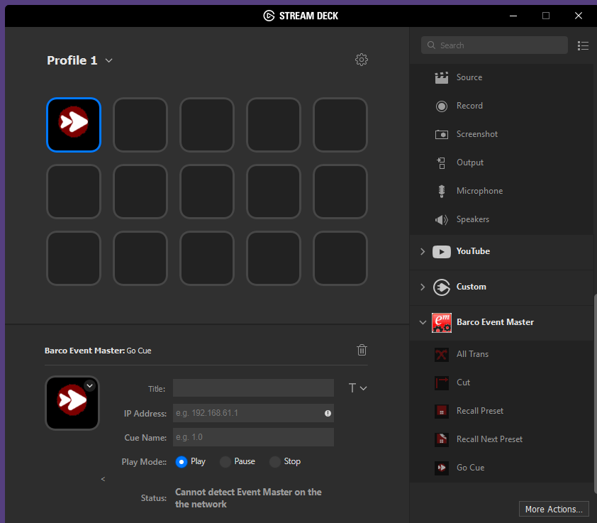
Go Cue Action
Drag and drop the action icon to the desired button
Provide:
Name and IP address
Play mode to Play, Pause or Stop the cue actions
Status will display “Connection Established” if able to connect to Event Master

Slide 9
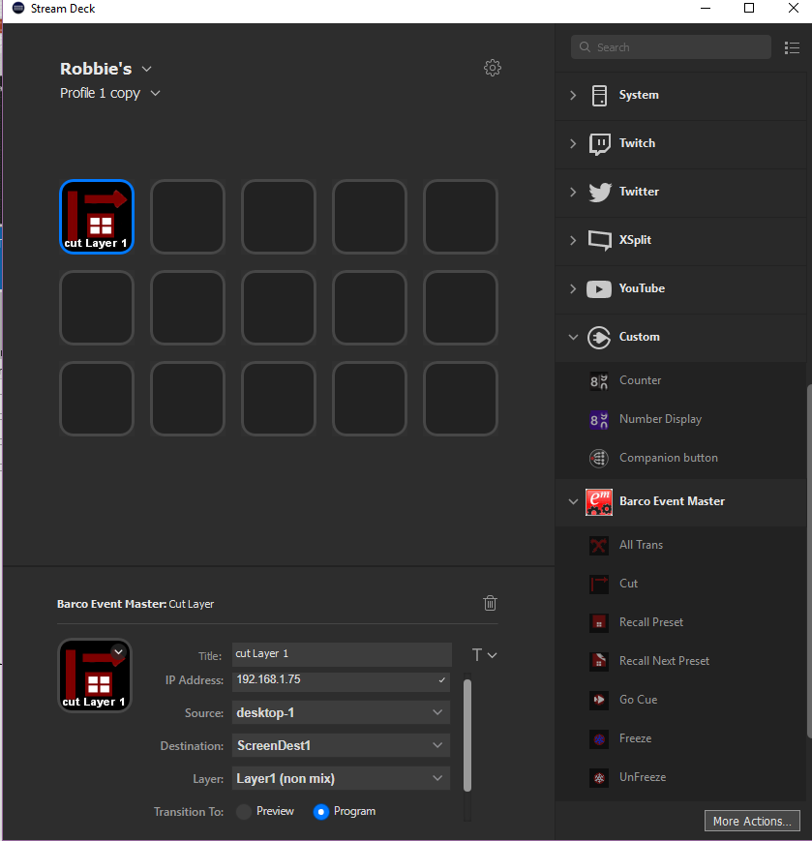
Change Source on Layer Action
Drag and drop the action icon to the desired button
Action to change a source for a given screen destination and layer
Provide:
Name and IP address
Source from the dropdown
Screen Destination from the dropdown
Layer from the dropdown
Status will display “Connection Established” if able to connect to Event Master
If the layer is a mix layer, the action will rely on the Preview or Program selection to determine the appropriate mix layer (A or B)

Slide 10
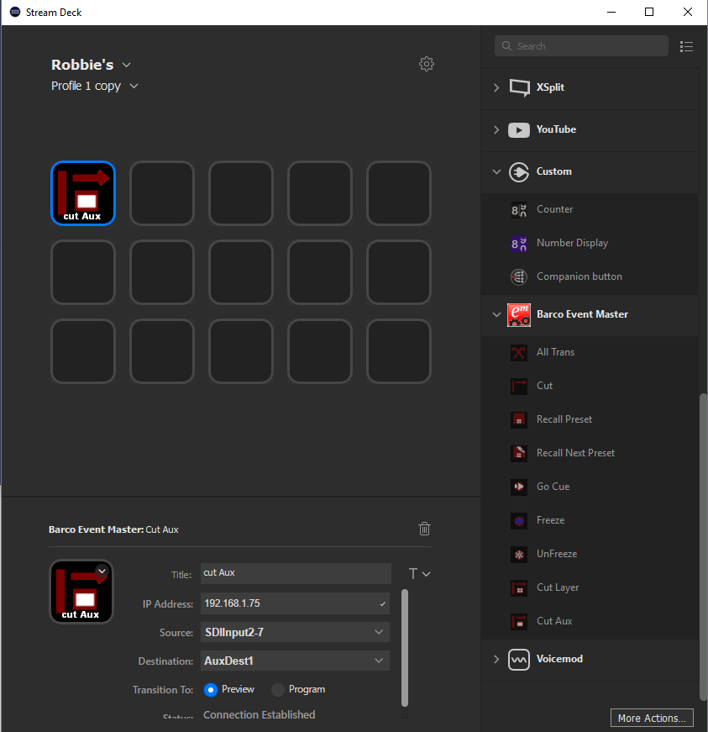
Source Replace on Aux Action
Drag and drop the action icon to the desired button
Action to change a source for a given aux destination and layer
Provide:
Name and IP address
Source from the dropdown
Aux Destination from the dropdown
Status will display “Connection Established” if able to connect to Event Master

Slide 11
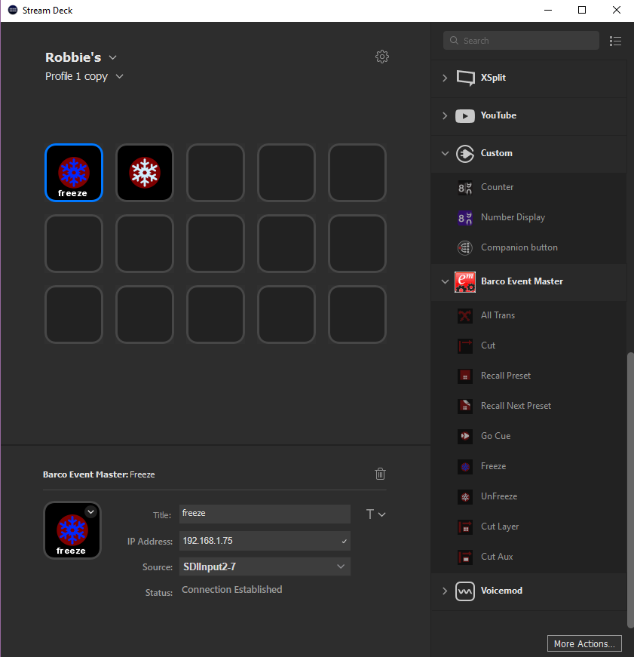
Freeze and UnFreeze Actions
Drag and drop the action icon to the desired button
Action to freeze and unfreeze a given live input or background source
Provide:
Name and IP address
Source from the dropdown
Status will display “Connection Established” if able to connect to Event Master
Destination sources are not listed

Slide 12

| youtube.com/BarcoTV
| linkedin.com/company/Barco
| twitter.com/Barco
| facebook.com/Barco
Example of how image can be used – find the right image in the DAM
12

